Slide 1
Therefore
I Feel，
I AM

Slide 2
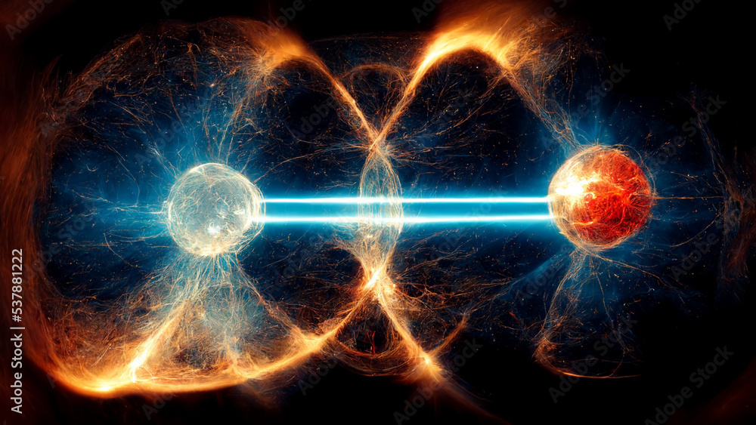
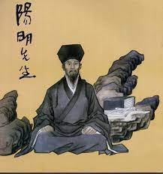

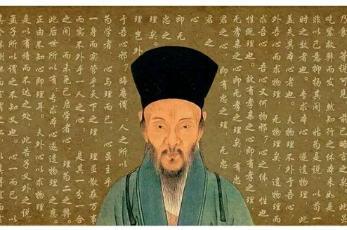

Inspiration

Slide 3
Inspiration
Wang Yangming--Philosopher
Heart-mind Theory
Quantum Entanglement
A quantum affects another quantum at superluminal speed
Flowering Tree in the Rock

Slide 4
Heart-mind Theory
Story：Flowering in the Rock
From 《The Biographical Record 》
Wang Yangming and his friend discussing the relationship between the heart-mind and the existence of external objects.
Wang Yangming think：“你未看此花时，此花与汝心同归于寂。你来看此花时，则此花颜色一时明白。
"When you do not look at this flower, it is silent with your mind. When you look at this flower, the colour it becomes clear"

Slide 5

Mind Map

Slide 6
